Slide 1
React Hooks
A deep dive into useMemo and useCallback
Notes:
Goal of the demo
Why we need them? When do we use them?
Efficient rendering of components
What is a react hook?
- When react was introduced, the components were class based, not function based.
- The class based is very complicated, involves life cycle methods like ComponentWillMount, ComponentDidMount, ComponentWillUnmount, ComponentDidUpdate, ShouldComponentUpdate.
componentDidMount -> useEffect(() => {}, [])
- componentDidUpdate -> useEffect(() => {}, […dependencies])

Slide 2

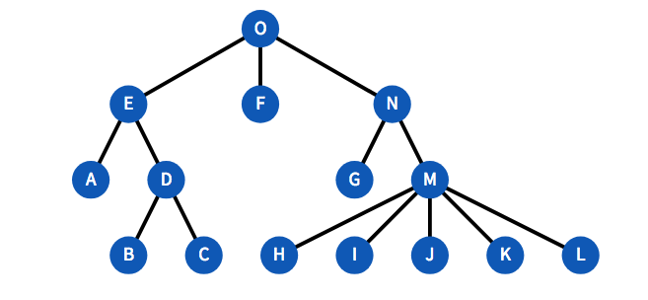
Component Tree

Slide 3
useMemo
In React, whenever the parent component renders, it renders all of its children components.
Re-renders are often expensive operations, that can lead to unnecessary recalculations.
Expensive computations, that could be a one-off operation, can slow down performance if performed redundantly.
useMemo helps optimize by memoizing (caching) the result of a computation until its dependencies change.
Notes:
Memoizing – Store computed result for performance improvement.
Think of it like calculating a tough math problem.
Without useMemo → every time someone asks you the answer, you pull out your notebook and solve the whole thing again.
With useMemo → you solve it once, write the answer down, and only recalculate if the numbers in the problem change.

Slide 4
DEMO

Slide 5
useCallback
In React, functions are re-created on every render, even if their logic doesn’t change.
Passing newly created functions as props can cause memoized child components to re-render unnecessarily.
Frequent re-creation of functions can also impact performance in lists or deeply nested components.
useCallback helps optimize by memoizing (caching) the function reference until its dependencies change.
Notes:
Think of it like saving your friend’s phone number in your contacts.
Without useCallback → you keep re-writing their number on a piece of paper every time you want to call, even though the number never changes.
With useCallback → you save the number once in your phone, and just use it when needed.
useMemo is for caching values, while useCallback is for caching functions.

Slide 6
DEMO
Notes:
Draw conclusions from the demo as to when re-rendering happens and when it doesn’t

Slide 7
When and Why do we need these?
Whenever a React Component re-renders, it re-renders all of its children unconditionally.
If you wrap a component in memo, it won’t re-render when its parent renders.
Wrapping the component prevents the entire component and its sub-tree from re-rendering when its parent renders.

Slide 8
When and Why do we need these?
When sending props to child components wrapped in memo(),
  sending the property by reference (non-primitive) re-renders the child component.
  Sending the property by value (primitive) does not re-render the child component.
This is due to shallow comparison in JavaScript which means two values are compared at the top level of their properties.

Slide 9
How is functions sent as props?
Functions are also sent as non-primitive values when passing from parent to child component.
Whenever an event handler is passed to child to alter a state in Parent, you typically don’t want to re-render child because of parent state update.
That’s when useCallback is useful.

Slide 10
useMemo vs useCallback
Feature | useMemo | useCallback
Purpose | Memoizes the result of a complex computation. | Memoizes a function definition.
Returns | A cached value. | A cached function.
Common benefit | Optimizes performance by caching computed values. | Optimizes performance by preventing unnecessary re-renders of child components that receives functions as props.

